Slide 1
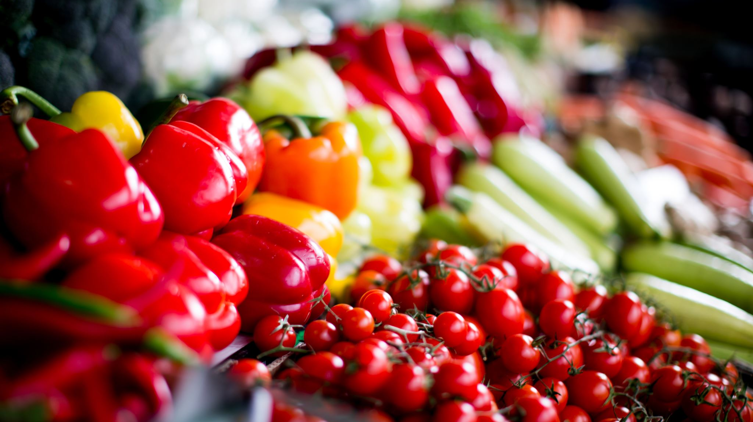
Food Saver App
Project Managers: Nagaraj Bhagwat, Japnit Singh Chawla
Scrum Masters: Furqaan Hyath, Tanjina Salam
Programmers: Ilka Jean

Slide 2
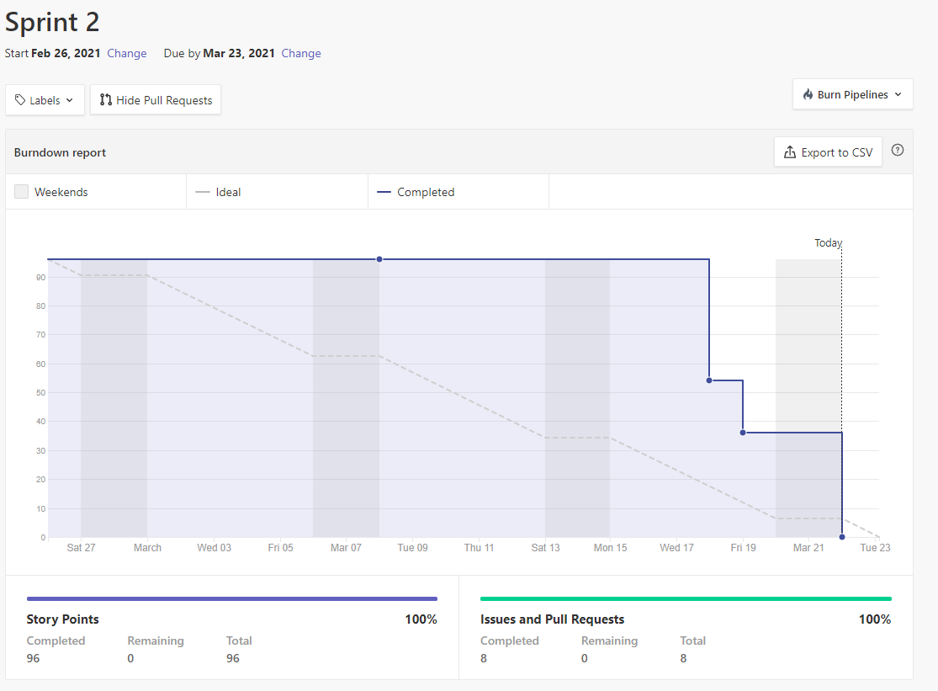
Burn down Chart

Slide 3
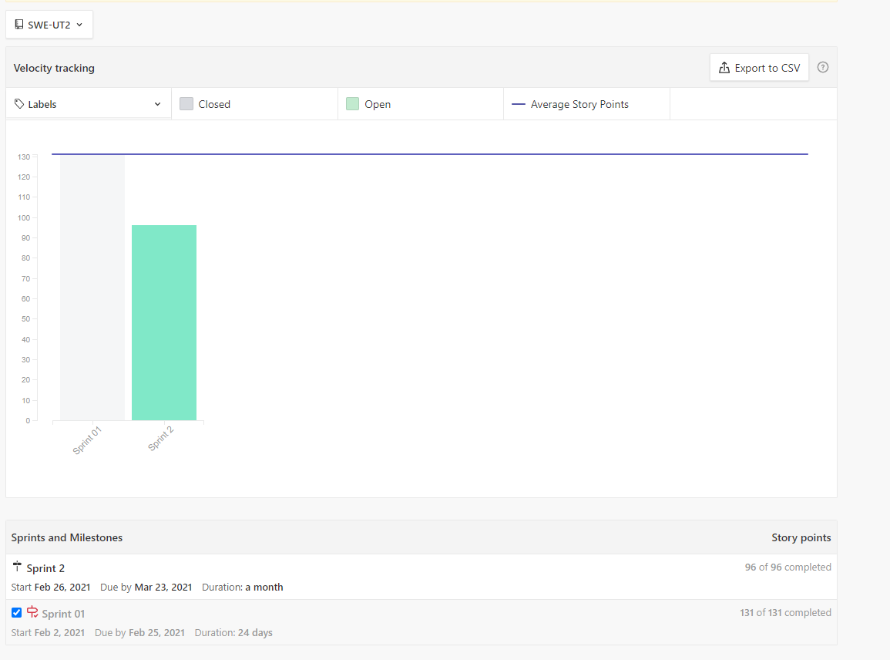
Velocity Chart

Slide 4
EPICS
Creating
UML Use Case Diagram
Creating
UML Sequence Diagram
Working
UI/UX Prototype
Android Studio with the necessary files
Setting

Slide 5
Epic 1:Creating a UML Use Case Diagram
Think about the User's Interaction and relationship with the application
It should show the different use cases in which the user is involved
Find a way to capture the functionality and requirements needed
Each SM created a Use Case Diagram, which will be featured on this presentation

Slide 6
Epic 2: Creating a UML Sequence Diagram
Think about how certain operations are carried out, and should capture the interactions between different objects
Will help us map out the interaction logic between these objects in the time order the interactions take place
Will be able to represent the details of the UML use case
Each PM made a sequence diagram, which will both be shown later

Slide 7
Epic 3: Setting up Android Studio
Having to set up Android Studio also includes having to install SDK components that are required for development.
Figuring out how Studio works, such as when creating a new project, we had to set up the emulator, and learn how to run the app on the emulator for the first time

Slide 8
Epic 4: Working on the UI/UX Prototype
Think about fundamental screen layouts, Information architecture, and navigation.
Need to be able to show basic screen designs that allows the user to complete their primary goals.
Will help us to conceptualize the app's basic functionality

Slide 9
Importance of a Sequence Diagram
A sequence diagram is a good way to visualize and validate runtime scenarios.
This can predict how the system might behave and help us discover responsibilities we may need to have when modeling the system.
The requirements expressed in the use cases are used in sequence diagrams in further detail

Slide 10
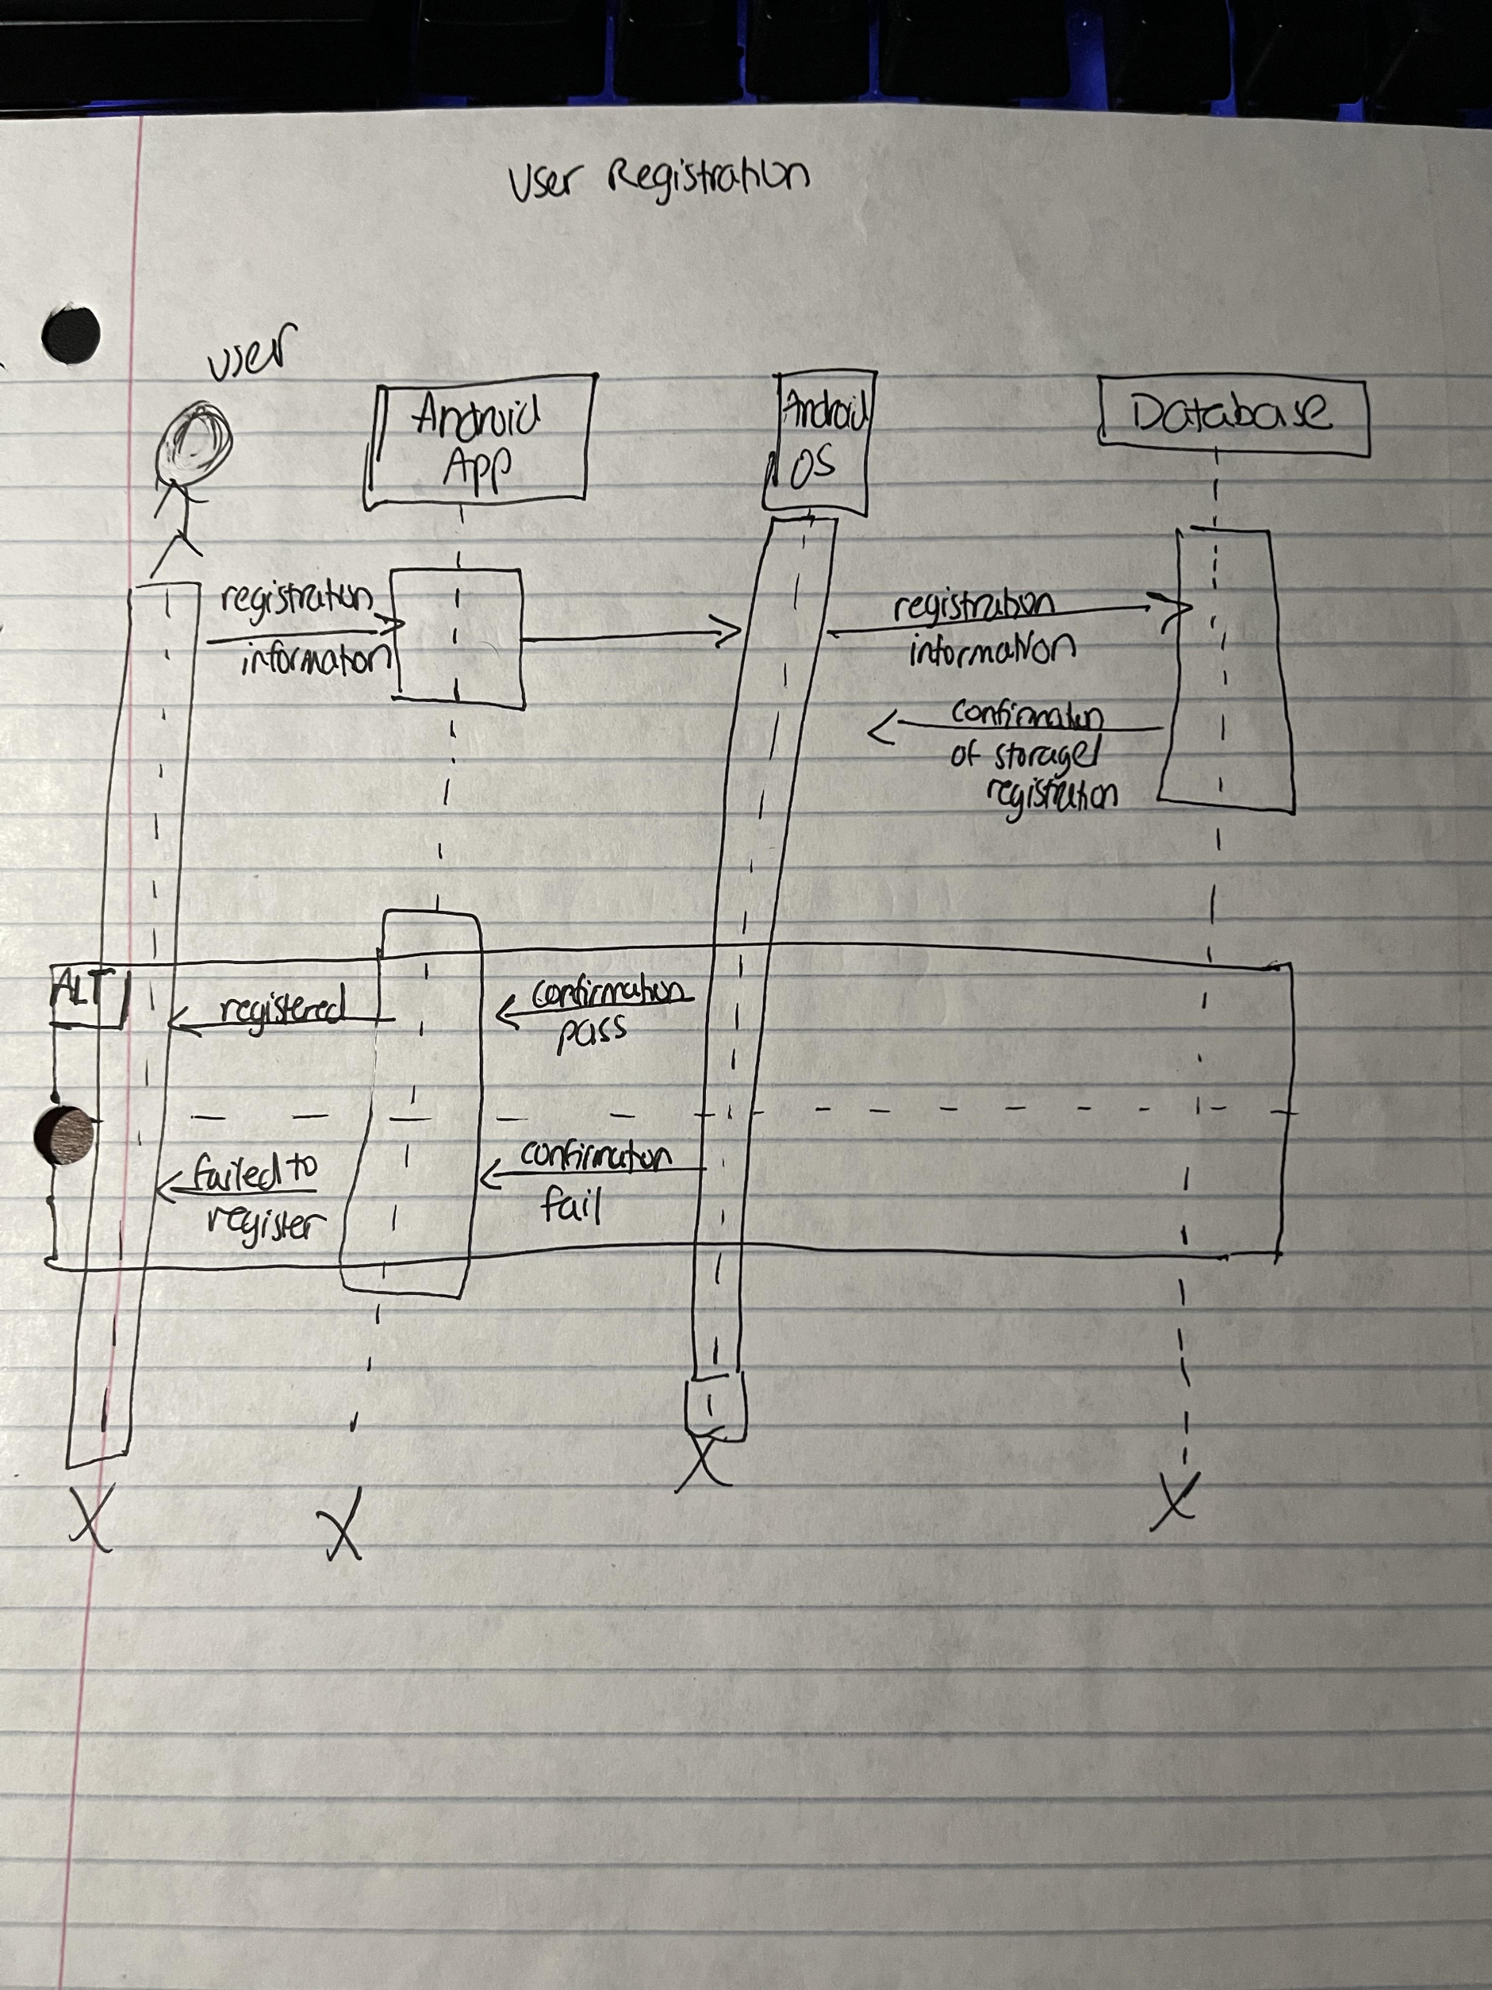
UML Sequence Diagram 1
Shows the process of User Registration. Important Note: All of the smaller edge cases for registration (Incorrect email syntax (no @ sign), name syntax (numbers for name), etc. are all checked beforehand in the application. The only check in the database is the email – ensuring it isn't already in the DB.
Actor: User
Objects: Android app, Android OS, Database

Slide 11
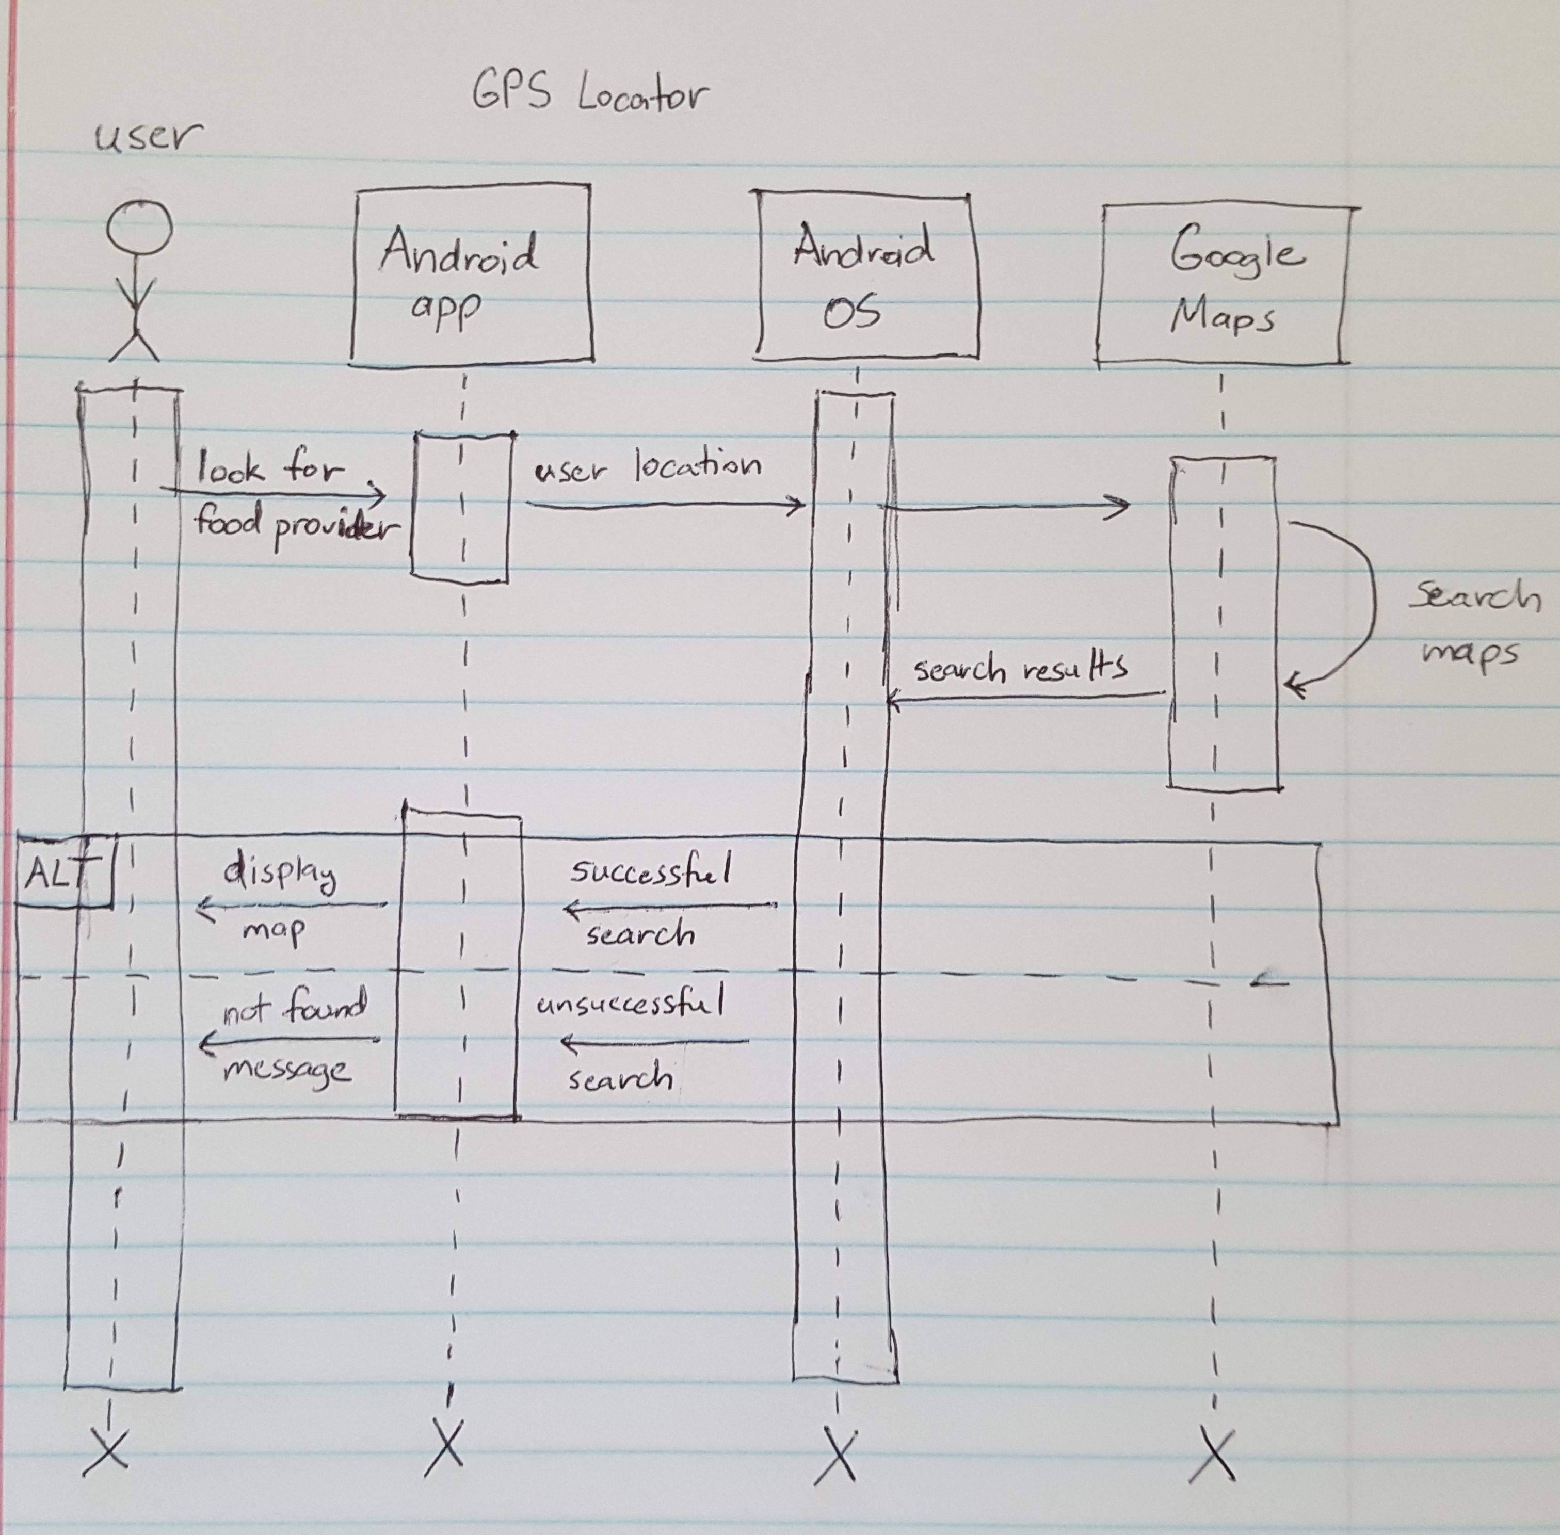
UML Sequence Diagram 2
Shows how GPS fetches location of user and displays maps of nearest food providers
Actor: User
Objects: Android app, Android OS, Google Maps

Slide 12
Importance of Use Case Diagram
Each Use Case has simple steps that that the user follows to reach their goal, with a use case, it can help us understand where errors can occur and how to resolve those issues.
A Use Case diagram will be able to show us how the user might interact with the system, at the end it should help us define and organize requirements

Slide 13
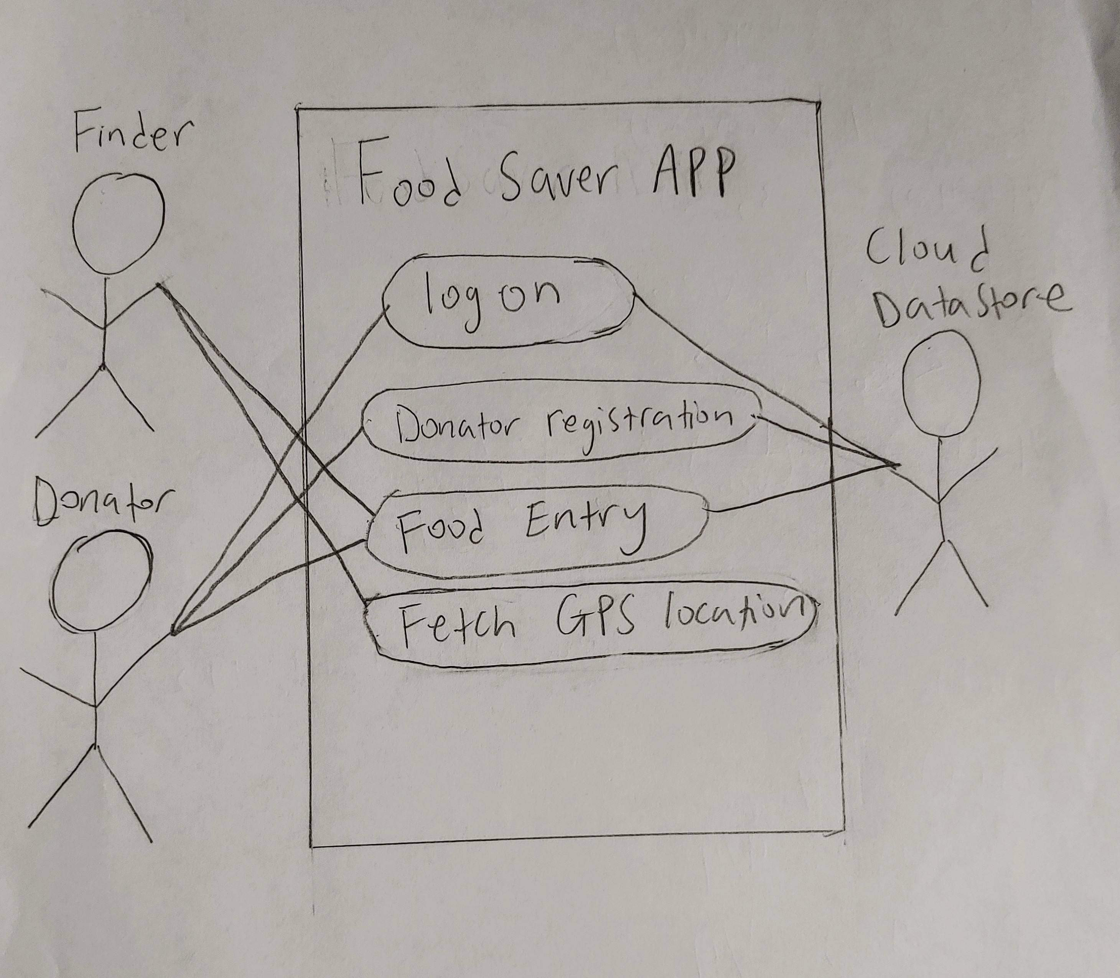
UML Use Case Diagram 1
Used to show the how the user can interact with the system and vice versa
Actors: Finder, Donator, and Database
Use Cases: Logon, Donator registration, food entry, fetching GPS location

Slide 14
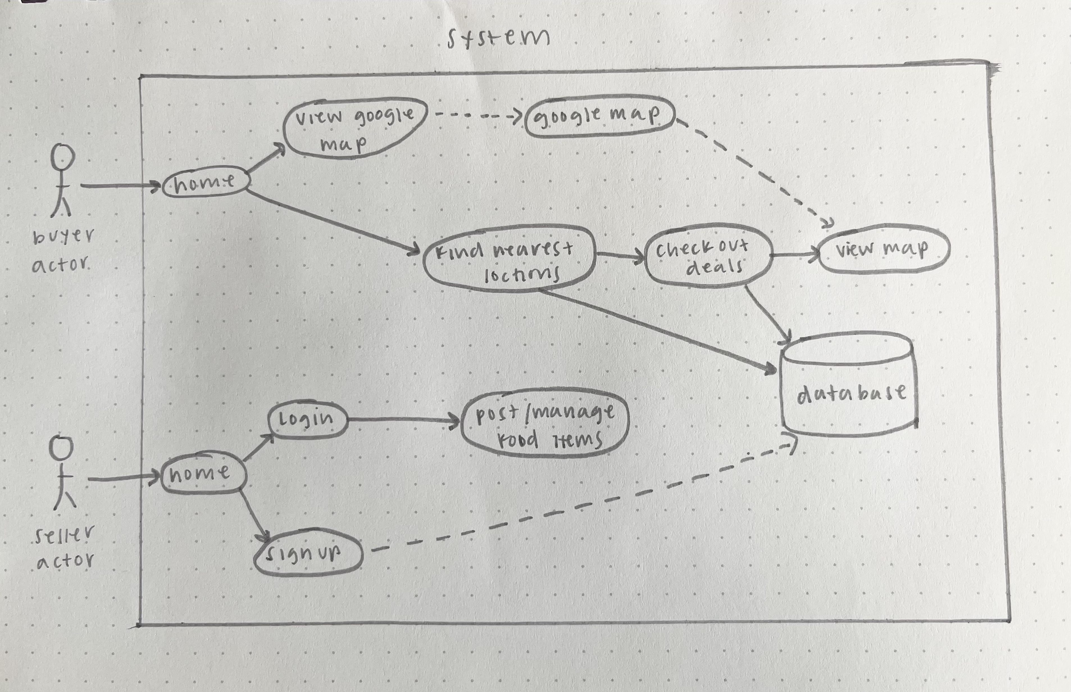
UML Use Case Diagram 2
Used to show user interactions and functionalities of the app
Shows the relationship of different use cases in which the user is involved

Slide 15

Prototype

Slide 16
What remains for Sprint 3
Creating
Creating a database and connecting it to our application
Logon authentication and authorization
Retrieving
Retrieving location of user with Google Maps API

